Slide 1
UpShift Digital Engineering Platform
Automated Insight to Modernization

Slide 2
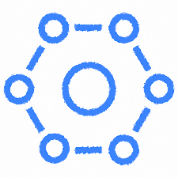
Automate and Scale application cloud transformation
Automated Cloud Readiness Assessment
From On-prem to target cloud
From one cloud platform to other cloud platform (PCF to OpenShift)
Service Templates
Accelerate Microservice Development
CI/CD Pipelines
Remediation Templates
Configurable Migration Settings
Transformation Recipes
Plugin integration
UpShift is an Intelligent Acceleration Platform for Application Cloud Transformation and Greenfield Application Development. It provides one click automation of cloud readiness assessment. It automates steps for transformation and deployment.
CUSTOMER ADOPTION: 100+ Customers
2

Slide 3
UpShift Digital Engineering Platform
Platform Offerings
1
One click application cloud readiness assessment (From On-prem to target cloud, From one cloud platform to other cloud platform (PCF to OpenShift)
Provides Tech stack suitability and migration complexity points
Recommendation on migration approach with remediation comments
Automated Cloud Readiness Assessment
2
Automated assessment of greenfield microservices code to identify microservices antipatterns
Microservices antipatterns pertaining to Service Discovery, API Decomposition, Reliability, Service Communication, Observability, Fault Tolerance and Distributed Tracing can be identified.
Accelerate Microservice development
3
Allows to define reusable Remediation Templates to fix the antipatterns.
Remediation Actions apply pre-defined parameterized changes to the source code.
The Remediation Actions serve different purposes. For example: Find and replace a string, Add / Delete an import statement and so on
Remediation Templates
4
Recommends Transformation Recipe based on Cloud suitability Analysis and source code analysis
Applies Recipes and recommends further changes that can be applied manually
Available Recipes include: Bootification of Struts, SpringMVC, and Apache CXF applications; Build tool migration; WebSphere to TomEE Buildpack / TomEE Docker; App Dockerization; EJB 2.x to 3.x; Jersey to Spring Boot; SOAP(JAXWS) to REST(Spring Boot), Jboss to Tomcat, Dockerize Classic ASP / VB.NET / C# applications and more
Transformation Recipes
5
Service Templates
Allows to define reusable service templates that can be set up once and reused to apply code changes.
The reusable templates serve different purposes. For example: adding build configurations, Adding a dependency in pom.xml and so on
6
Continuous Integration and Deployment Pipelines
Automated CI/CD job creation using pipeline templates uploaded by users
Allows to trigger deployment to target platforms such as PCF, AWS and Azure
7
Configurable Migration
Settings
Migration tools and plugins can be configured
Service templates and CI/CD templates configuration
8
Running your own UpShift Plugin
Provides option to extend the features using Plugins
A plugin application created using UpShift guidelines can be run as a blueprint flow within the platform
3

Slide 4
Automated Cloud Readiness Assessment
1
Platform provides automated Portfolio Assessment to analyze Cloud Readiness for Java, .NET & PHP applications
Assessment can be targeted for specific platforms like PCF, Azure, AWS Lambda, Containers, Docker, Kubernetes & Generic Cloud
Assessment can be targeted for transformation from one cloud platform to the other e.g. PCF to OpenShift
1500 pre-configured static rules to identify the anti-patterns; Analyze hundreds of applications in Minutes
Provides ability to customize static rules and add new rules using Machine Learning
Provides comprehensive Cloud Readiness Assessment Report for each application
Also provides capability to determine Cloud suitability based on custom rules and Machine Learning
Highly Secured
All Source Code and Report remain local
No Upload required
Works offline
Easy to Install
No additional infrastructure
No custom installation
Just download and run
Easy to Use
Run Command
View Report!
Remediation suggested
AI Empowered
More coverage of Anti Patterns using ML
User based ML Training
Highly Secured
All Source Code and Report remain local
No Upload!
Works offline
Easy to Install
No infrastructure
No custom installation
Just download and run
Easy to Use
Run Command
View Report!
Remediation suggested
AI Empowered
More coverage of Anti Patterns using ML
User based ML Training

Slide 5
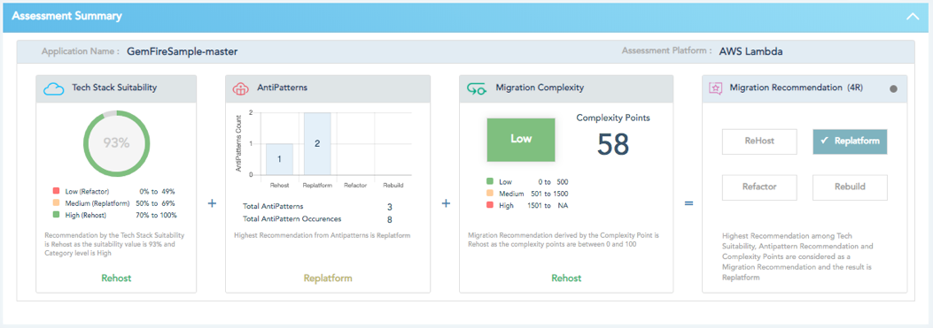
Sample Assessment Report - Application Details
Migration Complexity
- The complexity level in migrating the application to cloud and the total complexity points to consider for application migration to Cloud
Assessment Details
- App name and the target platform
Tech Stack Suitability
- Suitability of the application tech stack to fit into a target cloud
Antipatterns
- A summary on the anti patterns detected in the application.
Migration Strategy
Provides the migration strategy for the application based on entire analysis.
Rehost - Lift And Shift Strategy
Replatform - Changes to be done at platform/framework level before migrating to cloud
Refactor - Refactoring to be done in the code to migrate the application to cloud
Rebuild - Rebuild the entire application as the existing code base will not fit in cloud.

Slide 6
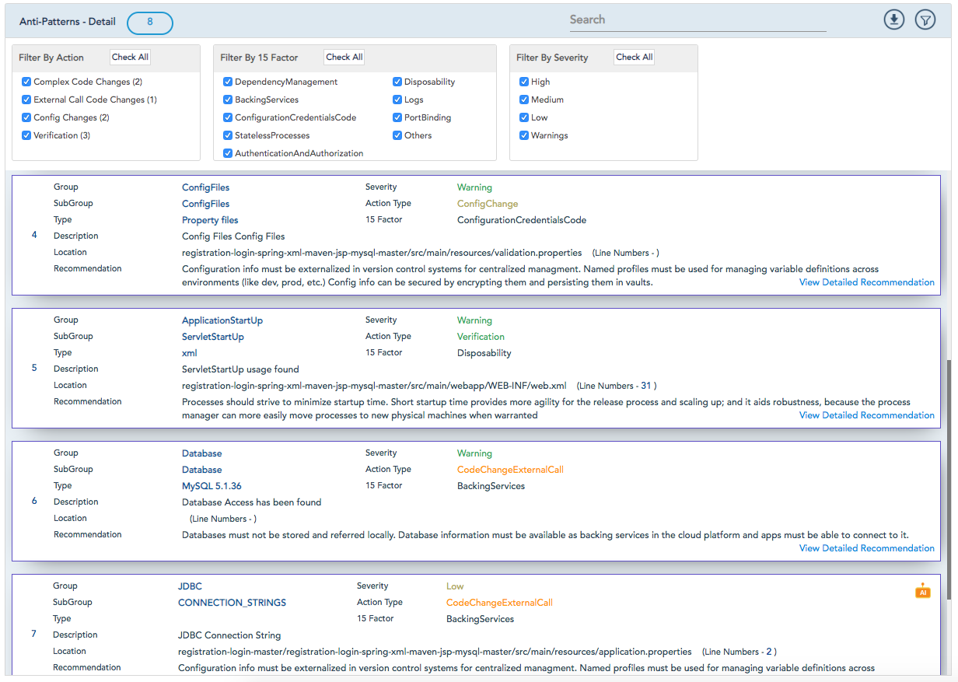
Sample Assessment Report - Anti Patterns Details
Recommendation
High-level recommendation is available here.
Detailed recommendation for each anti-pattern can be viewed by clicking on ’View Detailed Recommendation’ link.
Anti-Patterns Detail
- Provides the details of each anti-pattern encountered in the application
Filter
- Provides an option to filter the anti-patterns based on severity, 15 factor, action and any text entered
AI Assessment
- Highlight indicates that the anti-patterns are identified through machine learning module of VSM

Slide 7
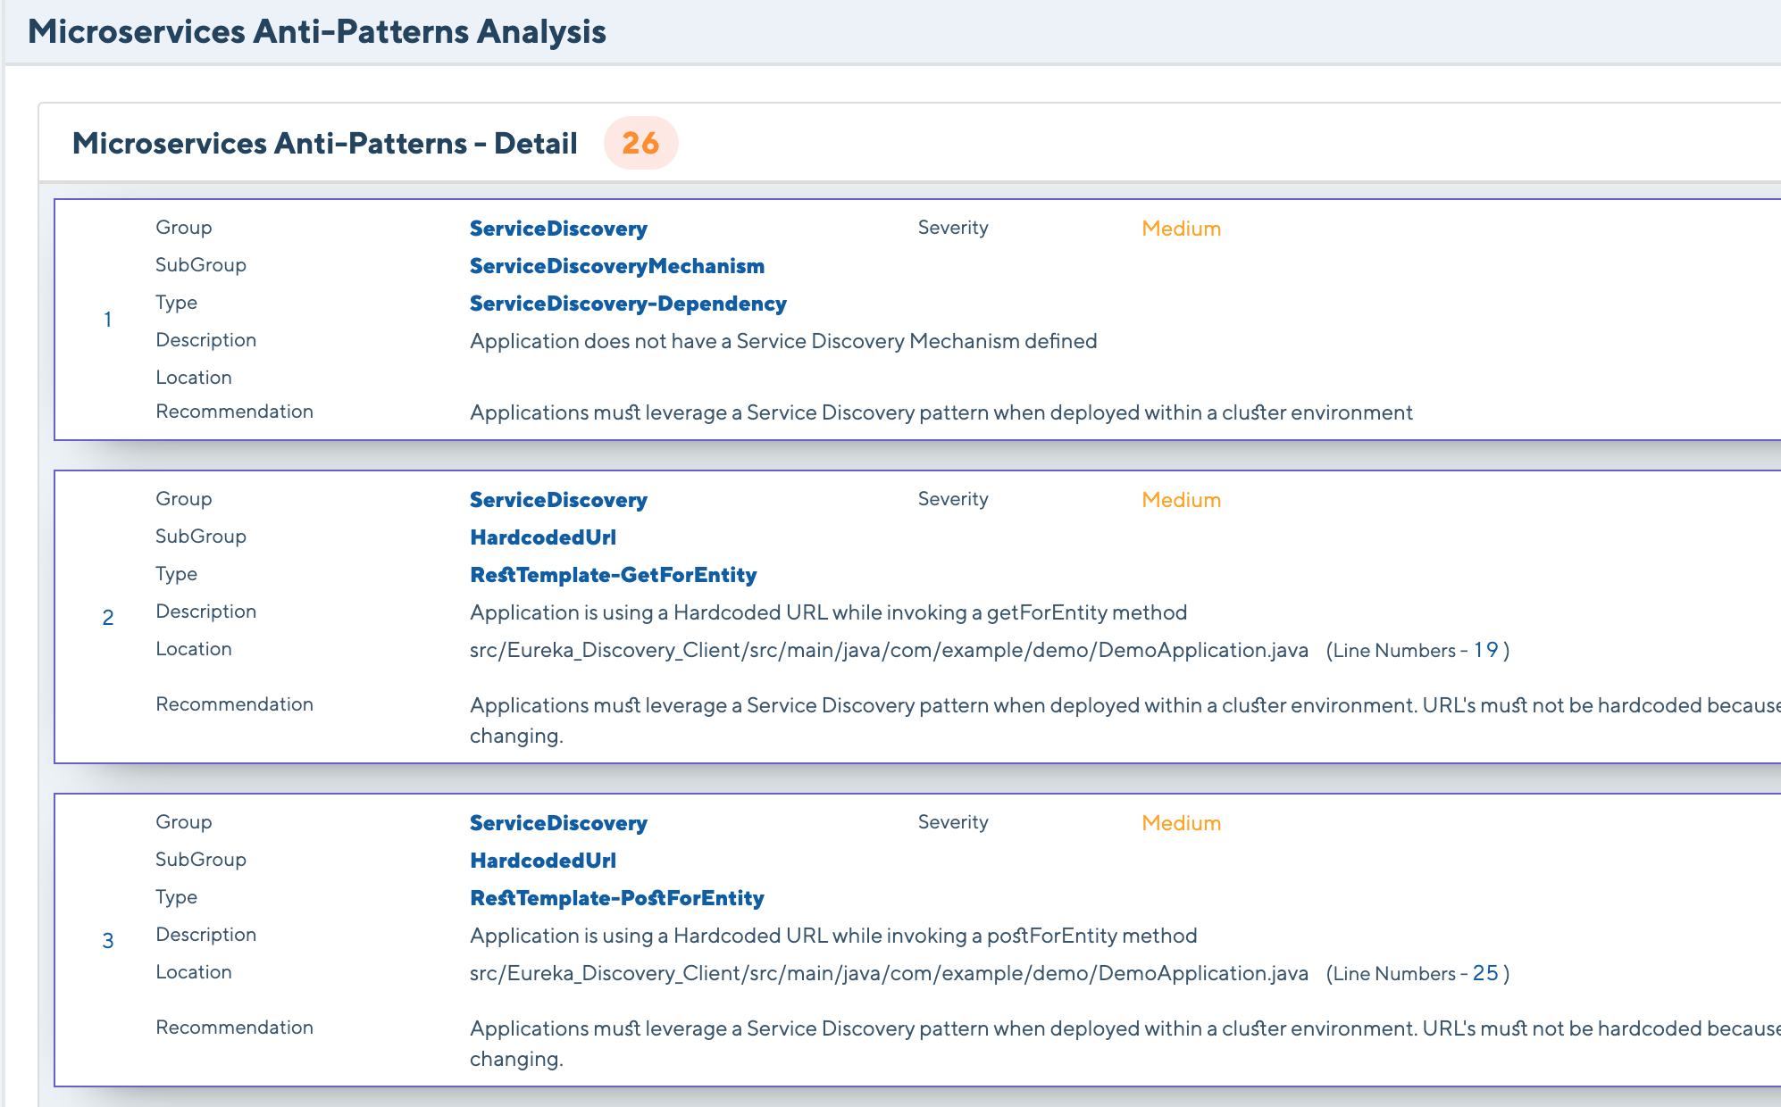

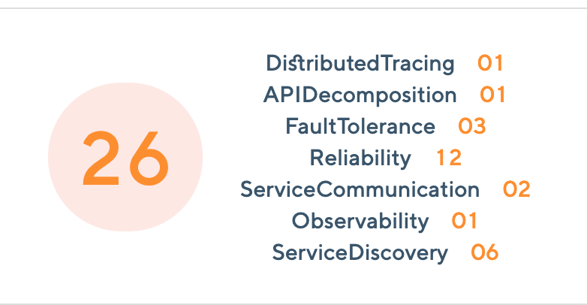
Accelerate Microservice development
2
Automated assessment of greenfield microservices code to identify microservices antipatterns
Assess the code generated from the below Tools
Spring Initializr
Micronaut
Assess microservices antipatterns pertaining to Service Discovery, API Decomposition, Reliability, Service Communication, Observability, Fault Tolerance and Distributed Tracing can be identified
Sample Assessment Report:

Slide 8
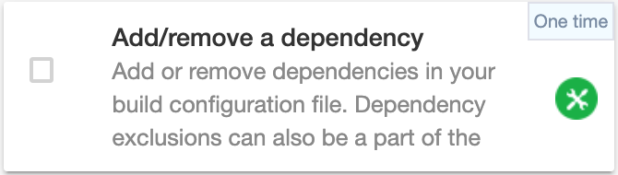
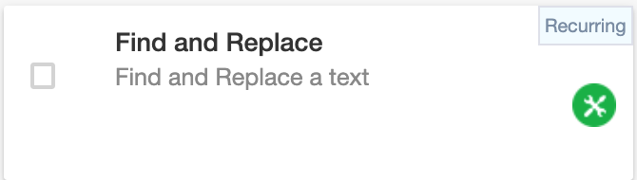
Remediation Templates
3
UpShift platform allows to define reusable Remediation Templates to fix the antipatterns in the source code for .Net and Java applications.
A Remediation template can be defined by adding one or more actions and can be associated to a selected antipattern. Each action applies pre-defined parameterized changes to the source code serving different purposes.
For example: Find and replace a string, Add / Delete an import statement and so on.
Example: Remediation Template Actions to replace an existing logger
User can configure the action to add or remove dependencies in build configuration file.
User can configure the action to find and replace text.
Example: search text - org.slf4j.LoggerFactory replace text: org.apache.logging.log4j.LogManager

Slide 9
Transformation recipes
4
Platform offers out-of-the-box transformation Recipes to transform target application source code into cloud native code
These recipes are available within the ‘Move Application to Cloud’ transformation flow in the UpShift Platform
Suitable recipes are suggested based on the application analysis
Recommendations for further manual actions on the transformed code are provided. Example: When applying the ‘Gradlize Maven App’ recipe, the maven plugins will not be migrated to their gradle equivalents. In this case, UpShift provides the list of maven plugins available and instructs the user to manually identify and add gradle equivalents
Available out-of-the-box transformation recipes:
Bootify Struts App
Gradlize Maven App
Spring MVC to Springboot
Wraps struts application with Spring Boot framework
Creates Gradle related files and folders based on Maven configuration
Automates Bootification of Spring MVC application
Websphere to TomEE Buildpack
Websphere to TomEE Docker
Apache CXF to Spring Boot
Automates Migration of Websphere Applications to PCF using TomEE Buildpack
Automates Migration of Websphere Applications to PCF using TomEE Docker image
Automates Bootification of Apache CXF application

Slide 10
Available out-of-the-box transformation recipes:
Dockerize Application
EJB 2 to 3
Jersey to Springboot
SOAP(JAXWS) to REST(Spring Boot)
Automates Dockerization of Applications with relevant App/Web server
Automates code changes for migration of sessions beans from EJB 2.x style to EJB 3.x style
Automates bootification of Jersey application.
Automates Bootification and SOAP to REST conversion of JAX WS application
JMS to RabbitMQ broker
Weblogic to Tomee Buildpack
Jboss to Tomcat
Automates migration from JMS broker to RabbitMQ broker using spring jmsTemplate
Deploy your Web profile Weblogic application to CF using Tomee Buildpack
Automates the transformation of JBOSS applications to be run on Tomcat
Ibatis (Mybatis) to Spring JDBC Template
JMS to AMQP Migration for Spring Integration
Message Driven Bean to Spring POJO
Transforms all Ibatis references to Spring JDBC Template
Transforms all JMS references to Spring AMQP spring configuration
Transforms Message Driven Beans to Spring's Message Driven POJOs
Spring Bootify EJB Session Beans
Dockerize .Net Application
Transforms EJB Session Beans to Spring boot. Supports transformation of EJB Message Driven Beans 3 (MDB3).
Dockerization of ASP.NET 4.5 (VB.NET & C#), Classic ASP, ASP.NET 2.0 & 3.5 applications (VB.NET & C#). Dockerization for multiple web project of a solution file in .NET

Slide 11
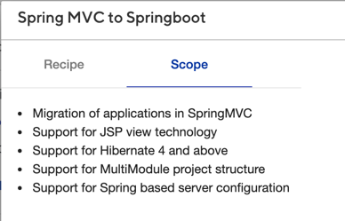
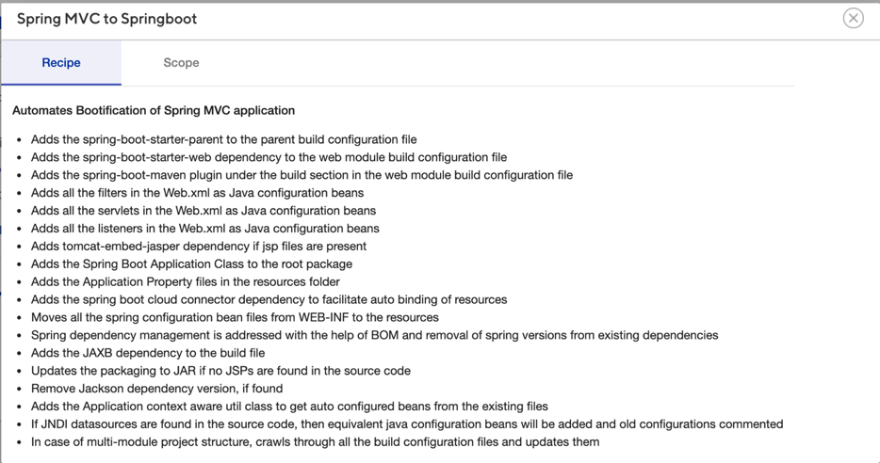
Example: SpringMVC to Spring boot Recipe
Transformation Recipe Steps
Transformation Recipe Scope
Example highlights the steps to transform codebase from SpringMVC to Springboot framework
Platform crawls through the application source code, understands current landscape and suggests target framework to transform application for Cloud
Upon user confirmation, platform transforms source code to target framework
In addition to automated transformation steps, UpShift platform also provides suggestions on the manual steps to be performed (if any)

Slide 12
Service Templates
5
Platform allows user to define Service Templates for injecting source code changes
They can be setup once by the user in the platform settings section and can be reused to make changes to several applications of similar kind
They serve a variety of purposes such as:
Adding build configurations to a maven or gradle project
Adding a dependency in pom.xml in a maven project
Service Template Types available in UpShift:
Adding a new file
Build configuration update - Maven
Helps to add a new file to the source code. For example, a servlet can be added to a particular package. Placeholders can be specified in the file so that actual values can be entered during the transformation flow.
Adds dependencies and dependency exclusions to the pom.xml file
Build configuration update - Gradle
Web xml Config Update
Adds Gradle configurations such as Plugins and DSL blocks to the build.gradle file.
Adds or updates web XML configurations such as Filters

Slide 13
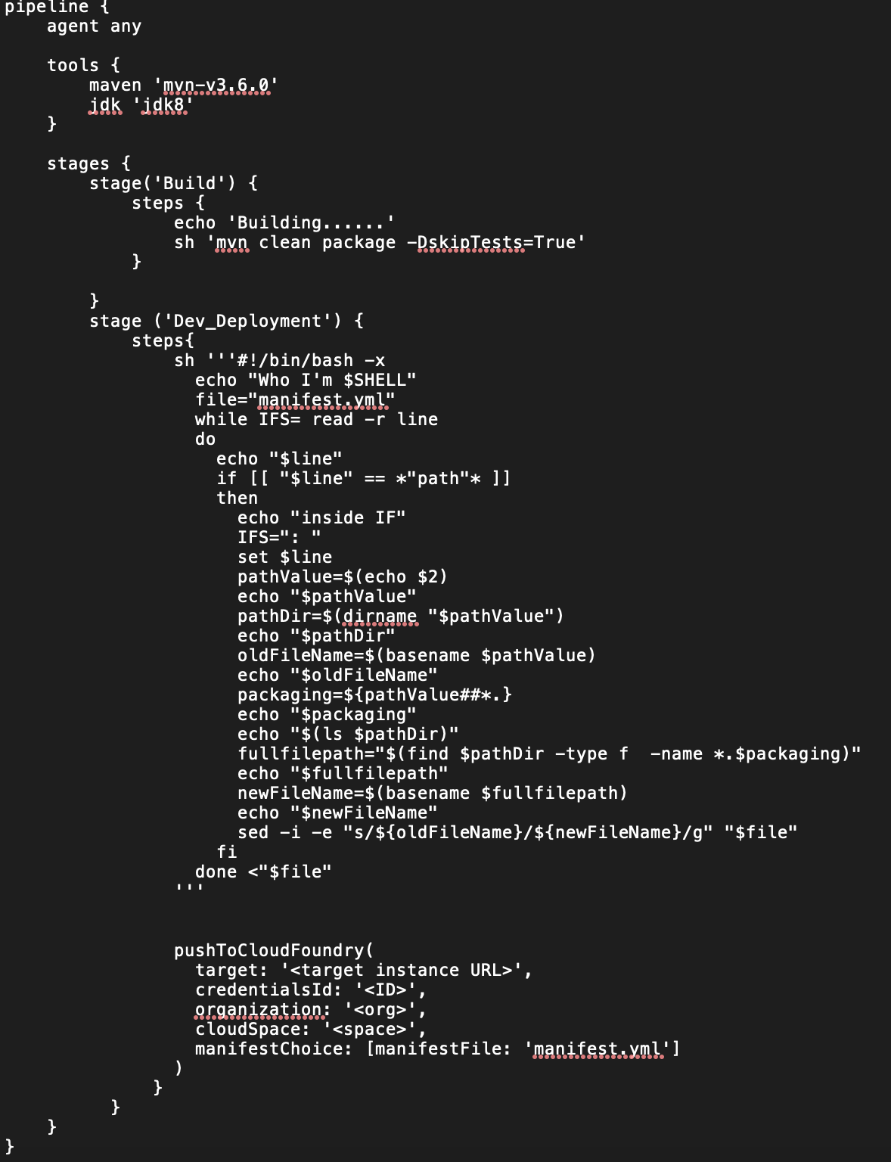
Automated CI/CD Pipelines Creation
6
The user creates a CI/CD template in UpShift settings by uploading their Jenkins files. Given below is a sample Jenkins file.
UpShift automates the creation of CI/CD pipelines using CI/CD templates uploaded by user
Currently UpShift platform supports Jenkins and creates the pipelines by creating and triggering a job in Jenkins
A CI/CD template can constitute one or more Jenkins Files.
The Jenkins service is configured in the Settings page.
Application, if cloud ready, will be deployed to target cloud platform using the pipeline created using the selected CI/CD template
The CI/CD pipelines created by UpShift can be reused for further iterations
The user is also allowed to specify placeholders within the Jenkins Files and enter the application specific values during the transformation flow.
The CI/CD Templates created by user will be available during the transformation flow. The user can pick one of the available templates. UpShift uses the template to automate create and trigger a job in Jenkins.

Slide 14
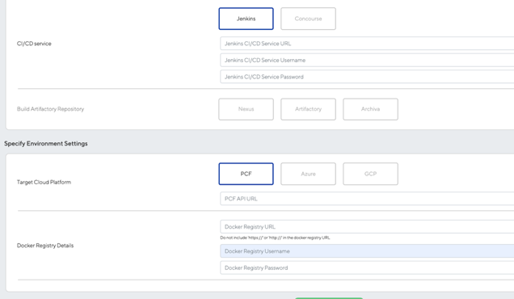
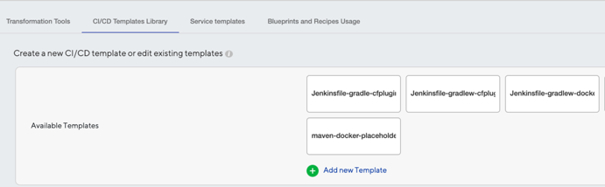
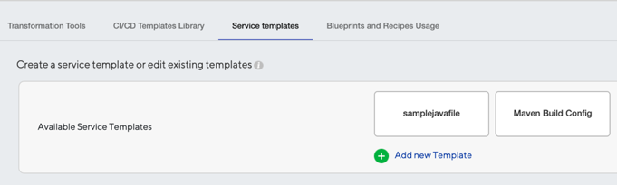
Application Migration Settings
7
Platform’s settings section allows user to configure the below:
Migration settings
CI/CD pipeline templates
Service templates
VSM Rules
Machine Learning Rules
Plugins
The CI/CD tool is selected and the service details are added here.
The target platform details are entered here
The docker registry details are provided here.
The Service Templates are configured here.
The CI/CD Templates are created here by uploading the Jenkins files.

Slide 15
Plugin integration
8
UpShift platform allows feature extensions through plugins.
The platform capabilities such as blueprint orchestration and dashboard can be leveraged to ship a feature to the end user very quickly.
Plugins can be registered and run as a blueprint workflow within UpShift.
Features
Plugins being developed
Register and upload a new plugin
Start UpShift with all registered Plugins
Start and execute a blueprint process instance
Delete a Plugin
.Net to .Net Core migration
Docker file analyzer
Option to transform applications from multiple source code repos
Notes:
edit

Slide 16
What UpShift will not address
UpShift Cloud assessment coverage does not include the Databases, Infrastructure & System DLL/JAR’s details.
UpShift Cloud assessment does not assess the security vulnerabilities.
UpShift Cloud assessment does not support war files.
UpShift Cloud assessment on the application specific DLL/JAR’s does not roll up to its final Migration Complexity Points or Recommendations
UpShift Cloud assessment can be done for Java and .NET COTS products as long as the source code is available. UpShift does not support Transformation of COTS products as it is the vendor’s responsibility and they are in a better place to perform the transformation.
UpShift platform will not provide recommendations on the target Infrastructure.
UpShift platform supports framework level changes to run the application in cloud. Example: Struts to Springboot transformation.
Some of the identified antipatterns can be fixed using Remediation templates configured by user. UpShift does remediate all of the identified antipatterns.
UpShift does not support database migration and data migration.
UpShift currently provides a set of recipes for framework level changes. To address problem areas for which support is not available, new recipes can be created in shorter release cycles.
With respect to CI/CD tools, only Jenkins service is supported currently. Customization effort would be involved to integrate other CI/CD tools.
UpShift platform currently only supports transformation of:
Java applications with Maven / Gradle as build tool and packaged as jar / war
.NET applications of type ASP.NET 2.0, 3.5, 4.5 & Classic ASP

Slide 17
Cloud Transformation Approach with UpShift
Assessment and Transformation of Application using UpShift
Run Automated Assessment in UpShift
Further Iterations
Collect Transformation Requirements
VSM
Review and strategize transformation approach
Establish Cookbook
Run Automated Transformation in UpShift
Deployment Successful
Identify tech stack suitability, migration complexity and Migration Strategy Recommendation
Further manual changes may be required
The CI/CD pipelines created by UpShift can be reused for further iterations
Collect Transformation Requirements on shortlisted applications
Set up series of discussions to understand the transformation requirements and preferences
Identify required remediation templates, transformation recipes, service templates, CI/CD templates
Establish Application Migration cookbook
Modify existing recipes to customer context, if required
Create new recipes, remediation template actions, transformation recipes, service template types, CI/CD templates
Modified source code will be available on a new Git branch (or in the local file system in case of UpShift Local)
Updated cookbook as a reference for future migrations
Run UpShift and apply remediation templates, transformation recipes, and/or service templates
Application, if cloud ready, will be deployed to target cloud platform using the CI/CD template

Slide 18
UpShift Installation Requirements
UpShift can be set up on Desktop / VM
UpShift Pre-requisites
OS & Memory : Windows 10 & above with 16 GB RAM
Software : Java 1.8 Update 161 & above. It is not certified with Java 1.9 & above.
Google Chrome browser
Internal Ports used : 8088, 8001, 5672, 8080 – No need to open them publicly.
UpShift as a standalone application can be installed locally on the desktop. UpShift installer is a Zip file. README.md file has the instructions for the installation.

Slide 19
Thank You

